Slide 1


How does a brain hemorrhage affect language usage?
Camille Peeters

Slide 2
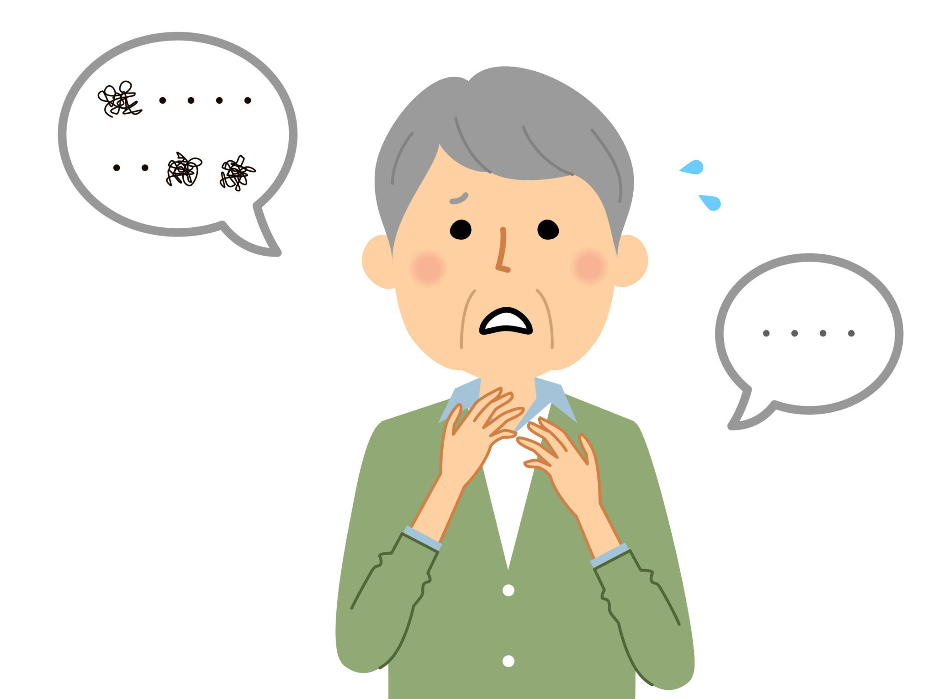
TABLE OF CONTENTS
LANGUAGE DISORDERS:
- Definition + types
APHASIA:
- Definition
- Broca’s aphasia
- Definition
- Examples
- Wernicke’s aphasia
- Definition
- Examples
CONCLUSION:
- It effects our use of language through the language disorder aphasia.
BRAIN HEMORRHAGE:
- Definition + symptoms

Slide 3
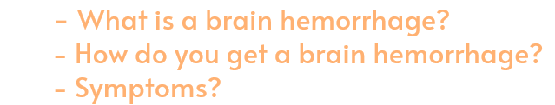
01.
BRAIN HEMORRHAGE

Slide 4
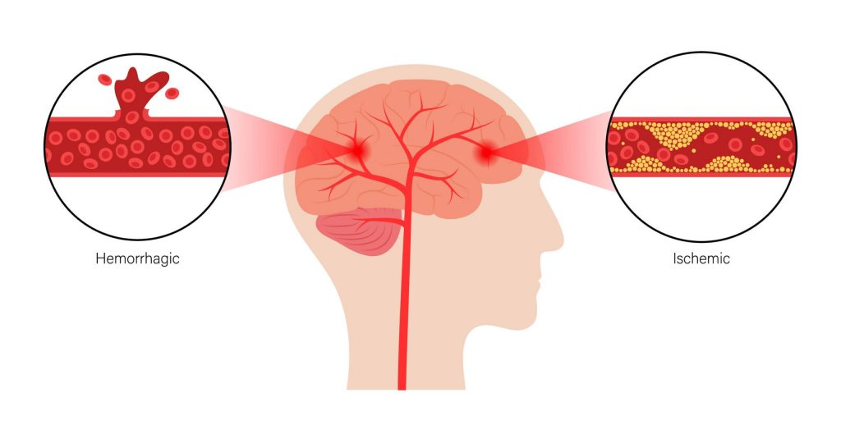
What is a brain hemorrhage?
A type of stroke
Brain cells start to die
Ischemic: obstructed
Hemorrhagic: ruptured

Slide 5


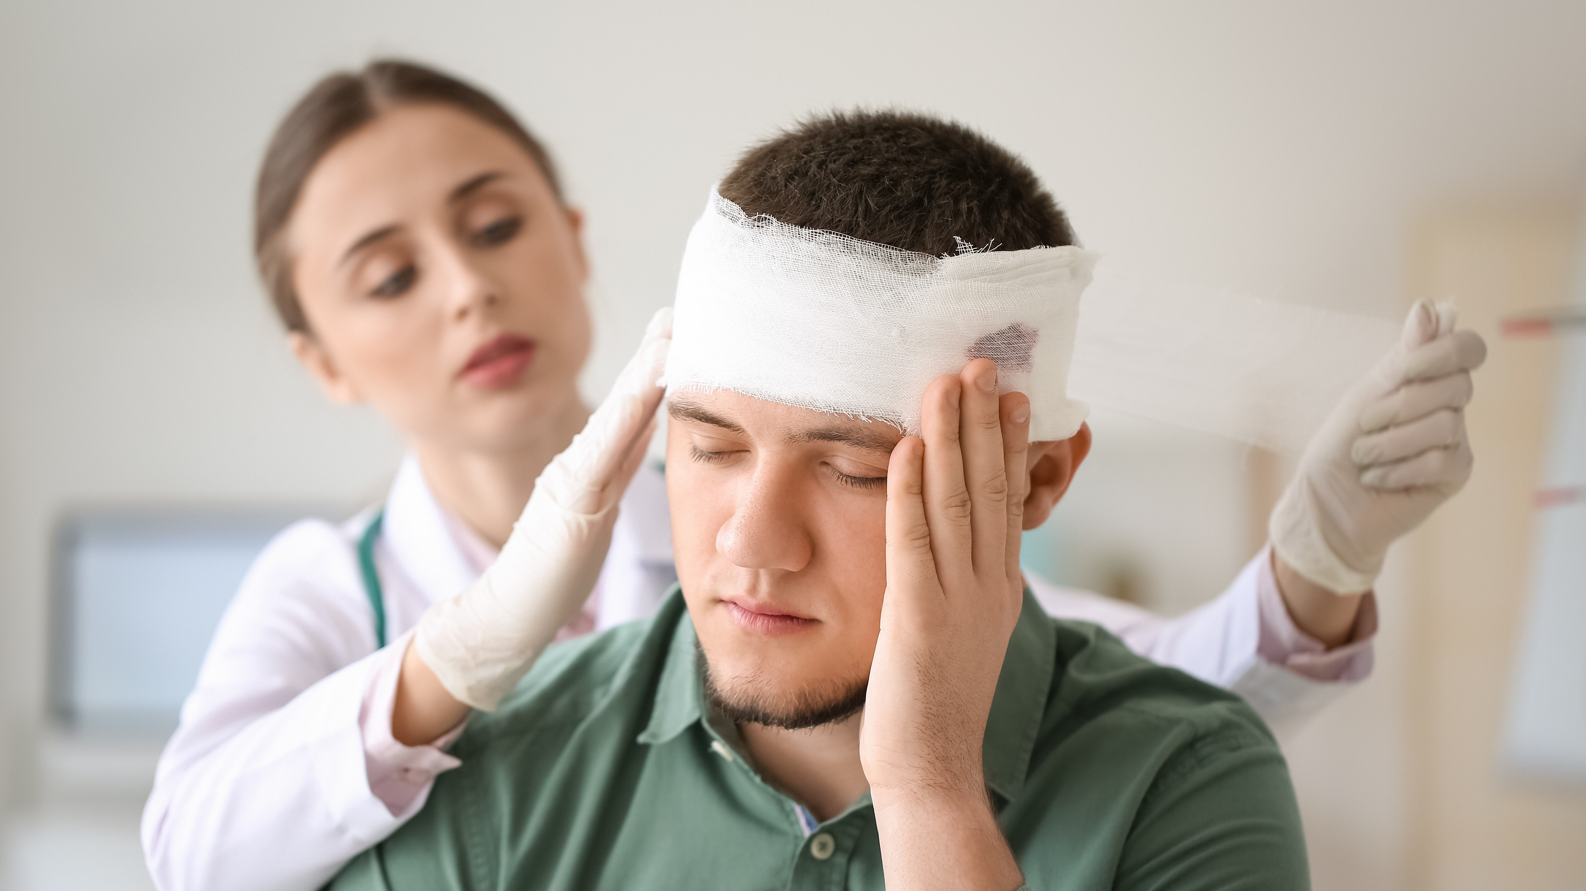



How do you get a brain hemorrhage?
Symptoms:
Brain tumor, bleeding disorders,…
Confusion, loss of movement,…

Slide 6
02.
LANGUAGE DISORDERS
- What is a language disorder?
- What types of language disorder?
- What type with brain hemorrhage?

Slide 7

What is a language disorder?
A type of communication disorder
Make it difficult to use and understand spoken language
Trouble using / understanding spoken language
It occurs in childhood (because you’re born with it)
You get it because of a brain injury or illness

Slide 8
What types of language disorder?
Expressive language disorder:
  Difficulty understanding a message during a conversation
  Difficulty putting words together
Receptive language disorder:
  Difficulty understanding what people say
Mixed receptive-expressive disorder:
  = Mix of receptive and expressive
With brain hemorrhage?

Slide 9
03.
APHASIA
- What is aphasia?
- Broca’s aphasia
- Wernicke’s aphasia

Slide 10
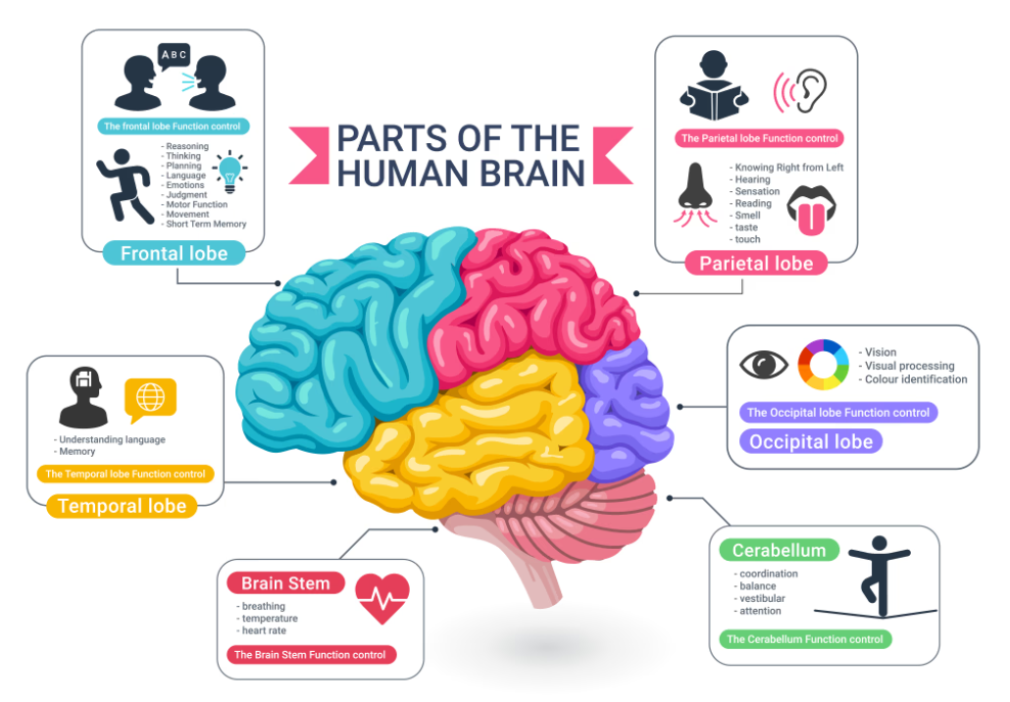

Slide 11
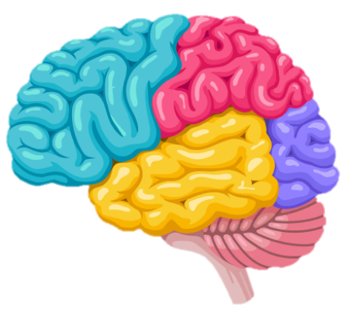
Broca’s area
= Language production
Broca’s aphasia
Wernicke’s area
= Processing and understanding language
Wernicke’s aphasia

Slide 12
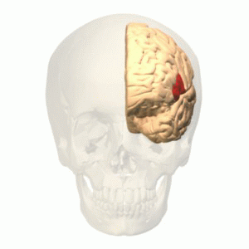
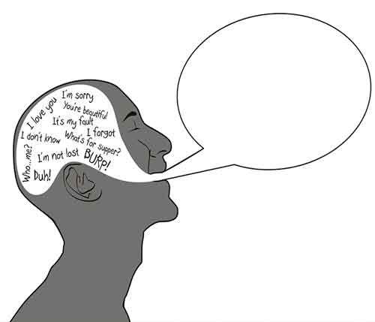
Broca’s aphasia:
= Expressive aphasia
Difficulty building sentences
Language production ≠ fluent
Limited language
Mispronouncing words
Mix up words

Slide 13
Broca’s aphasia:
Telegram style / telegraphic speech:
= How children build sentences (18-24 months)
“Cat drink milk” “This shoe all wet”
≠ articles

Slide 14
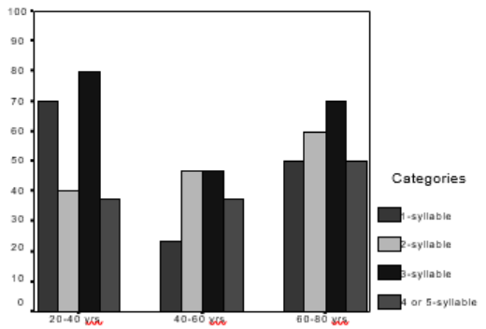
Broca’s aphasia:
Mean percentage occurrence of TOTs across age for aphasic population:
Tip of the tongue effect (TOT) :
(Professor Shyamala, the Speech Institute of India, 2021)
≠ recall a familiar word
= recall words of similar form and meaning.

Slide 15
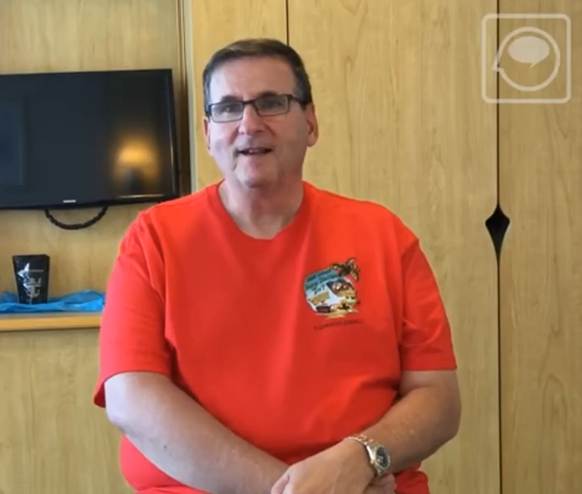
Broca’s aphasia:
Example:
Notes:
https://www.youtube.com/watch?v=JWC-cVQmEmY

Slide 16
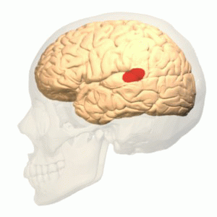

Wernicke’s aphasia:
= Receptive aphasia
Fluent speech
Doesn’t make sense
Word salad

Slide 17

Wernicke’s aphasia:
Use of verbs:
“Mother is away here working her work to get her better, but when she’s looking the two boys looking in the other part.”

Slide 18
Wernicke’s aphasia:
Long sentences:
“Mother is away here working her work to get her better, but when she’s looking the two boys looking in the other part.”

Slide 19
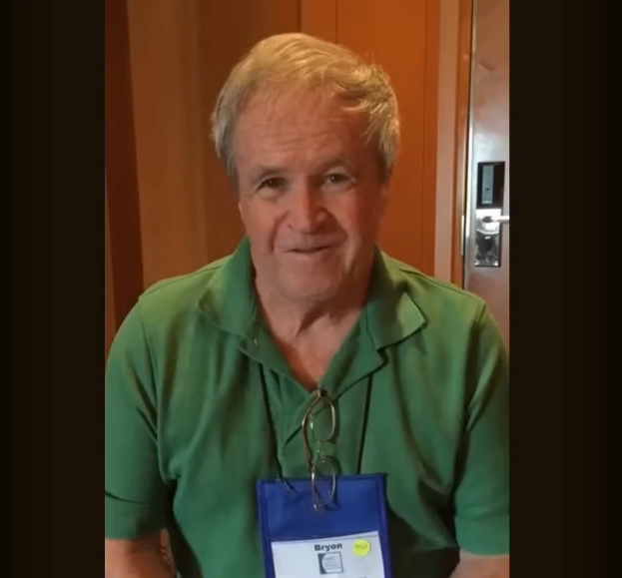
Wernicke’s aphasia:
Example:
Notes:
https://www.youtube.com/watch?v=3oef68YabD0

Slide 20

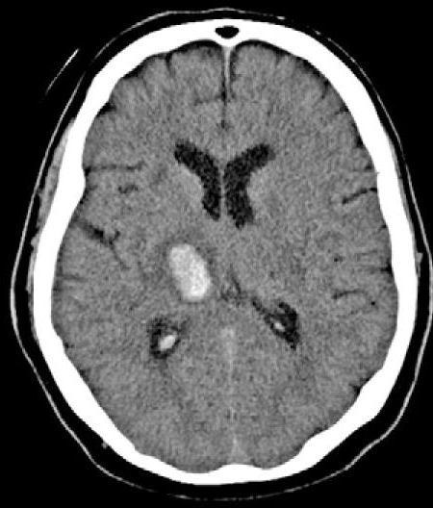
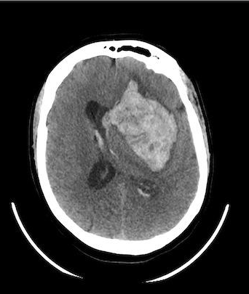
Not always going to completely affect 1 part
Both areas effected → mixed expressive-receptive language disorder
A piece of one area
Location / size of bleeding
In reality → difficult to speak of types

Slide 21
“It’s like a silent condition – people don’t realise what’s going on.”
(Colin Lyall, 2023)

Slide 22
How does a brain hemorrhage affect language usage?
Brain hemorrhage can lead to the language disorder ‘aphasia’
2 types of aphasia: Broca’s aphasia and Wernicke’s aphasia
In each type of aphasia, language is affected in a different way

Slide 23
SOURCES:
Lingraphica. (2023, 2 maart). What is aphasia? | Lingraphica. The Aphasia Community.
https://www.aphasia.com/aphasia-library/what-causes-aphasia/stroke/
2. [Different types of aphasia caused by cerebral hemorrhage in the left frontal lobe: Broca’s aphasia and Broca area’s aphasia]. (2009, 1 oktober). PubMed. https://pubmed.ncbi.nlm.nih.gov/19882959/
3. Aphasia - Symptoms & Causes - Mayo Clinic. (2022, 11 juni). Mayo Clinic. https://www.mayoclinic.org/diseases-conditions/aphasia/symptoms-causes/syc-20369518
4. Wright, S. (2008, 12 oktober). Brain hemorrhage: Causes, symptoms, treatments. WebMD. https://www.webmd.com/brain/brain-hemorrhage-bleeding-causes-symptoms-treatments
5. Professional, C. C. M. (z.d.). Brain bleed, hemorrhage (Intracranial hemorrhage). Cleveland Clinic.
https://my.clevelandclinic.org/health/diseases/14480-brain-bleed-hemorrhage-intracranial-hemorrhage
6. Belsky, G. (2023, 5 oktober). What are language disorders? Understood. https://www.understood.org/articles/what-are-language-disorders
7. Intracranial hemorrhage | Aurora Health Care. (z.d.). Aurora Health Care. https://www.aurorahealthcare.org/services/neuroscience/brain-skull-base-care/brain-hemorrhage/

Slide 24
8. Website, N. (2023, 22 augustus). Treatment. nhs.uk. https://www.nhs.uk/conditions/aphasia/treatment/
9. Afasie - expressieve vorm / Taal- en spraakproblemen / Gevolgen | Hersenletsel-uitleg.nl. (z.d.). https://www.hersenletsel-uitleg.nl/gevolgen/taal-en-spraakproblemen/afasie-expressieve-vorm
10. BabySparks. (2021, 4 januari). Telegraphic Speech: What It Is and How It Develops. BabySparks. https://babysparks.com/2019/10/02/telegraphic-speech-what-it-is-and-how-it-develops/#:~:text=Telegraphic%20speech%20is%20simply%20two,communicate%20their%20thoughts%20and%20feelings.
11. tactustherapy. (2017, 14 juni). Broca’s aphasia (Non-Fluent aphasia) [Video]. YouTube. https://www.youtube.com/watch?v=JWC-cVQmEmY
12. Types afasie - Afasietherapie. (2020, 7 juli). Afasietherapie. https://www.afasietherapie.be/voor-mensen-met-afasie/wat-is-afasie/types-afasie/#:~:text=Mensen%20met%20afasie%20van%20Wernicke,veel%20werkwoorden%20in%20hun%20zinnen.
13. “Tip of the Tongue Phenomenon” in Normal and Aphasic Adults: An Exploratory Study. (z.d.). https://www.ijsrp.org/research-paper-0421.php?rp=P11211132
14. tactustherapy. (2015, 8 september). Fluent aphasia (Wernicke’s aphasia) [Video]. YouTube. https://www.youtube.com/watch?v=3oef68YabD0
15. Hall, L. (2023, 29 juni). Raising awareness of aphasia - a “silent condition”. ITV News. https://www.itv.com/news/2023-06-29/raising-awareness-of-aphasia-a-silent-condition

